Slide 1
Early identification and detection of driver drowsiness by hybrid machine learning
Guided By,
Mrs. P Innasi Lineta
AP/CSE
Group Members,
Alpha Joseph (961418104009)
Cilla Joy (961418104024)
Reeja Ann Oommen (961418104044)

Slide 2
Problem statement
Driver drowsiness is one of the reasons behind the accidents that can cause serious death, injury and economic loss.
Statistics indicate the need of a reliable driver drowsiness detection system which could alert the driver before a mishap happens.
In this project, we have implemented the application of support vector machine and image processing clustering methods for real time classifications and analysis by taking the input.

Slide 3
OBJECTIVE
In this project, we have implemented real-time image segmentation and driver drowsiness detection using machine learning methodologies.
In the proposed work, an emotion detection method based on Support Vector Machines (SVM) has been implemented using facial expressions.
Project that localizes and tracks the vehicle driver's eyes and head movements developed to detect drowsiness.
To locate the pupils, the project uses a mix of template-based matching and feature-based matching.
During monitoring, the proposed method decides whether eyes are open or closed, and whether the driver looks in front.

Slide 4
LITERATURE SURVEY
SI NO | TITLE | AUTHOR | JOURNAL & YEAR | METHODOLOGY | ADVANTAGES & DISADVANTAGES
1. | Driver drowsiness detection based on respiratory signal analysis | F.Guede-Fernandez, N. Fernandez-Chimeno, J. Ramos-Castro, & M.A. Garcia- Gonzalez | IEEE Access 2019 | Thoraecic Effort Derived Drowsiness index (TEDD) algorithm. | performed comparative examinations on EEG information to decide the drowsiness of a driver. high respiratory rate variability are not only caused by fighting to fall asleep but also driver's movements, speak- ing and coughing
2. | Comprehensive drowsiness level detection model combining multimodal information. | M. Sunagawa, S.-I. Shikii, W. Nakai, M. Mochizuki, K. Kusukame, and H. Kitajima, | IEEE Sensors 2020 | Machine learning methods such as neural network and Support vector machine . | The first distinguished the eye squinted from the recorded EOG information It removed the eye top development parameters as highlights to be characterized using Support Vector Machines (SVM). Vehicle data are not sufficient to have a good accuracy for drowsiness classification.
3. | A smartphone-based drowsiness detection and warning system for automotive drivers | A. Dasgupta, D. Rahman, and A. Routray, ‘‘ | IEEE Trans. Intell. Transp. Syst., vol. 20 2019 | PERCLOS,VUR | used progressive image sifting systems such as picture subtraction, morphologically closed activities, and binarization. Speed of the vehicle cannot be controlled.

Slide 5
SI NO | TITLE | AUTHOR | JOURNAL & YEAR | METHODOLOGY | ADVANTAGES & DISADVANTAGES
4. | A survey on state-of-the-art drowsiness detection techniques. | M. Ramzan, H. U. Khan, S. M. Awan, A. Ismail, M. Ilyas, and A. Mahmood | IEEE Access 2019 | Support Vector Machine (SVM) ,Convolutional Neural Network (CNN),Hidden Markoll Model. | removed essential highlights from the fleeting contrast of sequential picture outlines. Vehicle based measures mostly affected by the geometry of road which sometimes unnecessarily activates the alarming system
5. | Driver behavior analysis for safe driving: A survey | S. Kaplan, M. A. Guvensan ,A. G. Yavuz, and Y. Karalurt | IEEE Trans. Intell. Transp. Syst., vol. 20 2015 | Fast Fourier Transform (FFT) ,Discrete Wavelet Transform (DWT), Support Vector Machine (SVM) ,Artifical neural networks (ANN) ,Linear discriminate analysis (LDA). | They utilized an R.I.R brightening framework and a high goal camera to acknowledge a surge of pictures and perform face and eye location. monitoring the driver drowsiness condition and alert the driver which reduces the road accidents
6. | A real-time driving drowsiness detection algorithm with individual differences consideration | F. You, X. Li, Y. Gong, H. Wang, and H. Li, | IEEE Access 2019 | Deep Cascaded Convolutional neural Network , Support Vector Machine, PERCLOS. | They followed the eye understudies utilizing non-straight Kalman and mean-move following. They likewise performed vertical and flat projections of the pixels around the eyes district. there should not be any reflective object behind the driver

Slide 6
SI NO | TITLE | AUTHOR | JOURNAL & YEAR | METHODOLOGY | ADVANTAGES & DISADVANTAGES
7. | Sensor applications and physiological features in drivers’ drowsiness detection | A. Chowdhury, R. Shankaran, M. Kavakli, and M. M. Haque | IEEE Sensors 2018 | Electroencephalogram(EEG),Electrocardiogram(ECG),Electroculogram(EOG),Skin Temperature ,Galranic Skin Response(GSR). | processed the twofold inclination and logarithm picture of the eyes area, acquired arbitrary examples around the locale, and utilized an elliptic shape to speak to the eyes. there should not be any reflective object behind the driver
8. | ‘‘Driver drowsiness classification using fuzzy wavelet-packet-based feature-extraction algorithm | R. N. Khushaba, S. Kodagoda, S. Lal, and G. Dissanayake | IEEE Trans. Biomed. Eng 2019 | Feature Extraction ,Electroencephalogram(EEG),Electrocardiogram(ECG), Electroculogram (EOG). | They additionally executed eye following to record the understudies’ breadth and shaped a vector of eye conclusion information of 15 seconds. At that point, they linked the two vectors and prepared an Artificial Neural Network (ANN) to decide the driver’s condition. It will not work with people having dark skin.
9. | A mobile application for driver’s drowsiness monitoring based on PERCLOS estimation | G. Soares, D. de Lima, and A. Miranda Neto | IEEE Latin Amer. Trans 2019 | Heart rate variability(HRV), Electroencephalogram (EEG),PERCLOS. | additionally joined conduct vehicle-based measures. They reasoned that the unwavering quality and precision of the half and half technique was altogether higher than those utilizing single sensors. The driving style of the current driver needs to be learned and modeled for the system to be efficient.

Slide 7
SI NO | TITLE | AUTHOR | JOURNAL & YEAR | METHODOLOGY | ADVANTAGES & DISADVANTAGES
10. | An effective hybrid model for EEG-based drowsiness detection | U. Budak, V. Bajaj, Y. Akbulut, O. Atila, and A. Sengur | IEEE Sensors 2019 | Elecroencephalogram(EEG),Long Short term memory (LSTM),Deep feature extraction. | recommend that observing the driver’s head posture and introduction can give enough pieces of information to anticipate the driver’s aim. The condition like micro sleeping which mostly happens in straight highways cannot be detected.

Slide 8
PROPOSEd system
The first step of the detection process is detecting eyes and mouth gestures to calculate and classify features with an SVM classifier.
This proposed approach has three stages: detecting face, detecting eyes and detecting drowsiness.
Image processing is used to recognize the face of the driver and then it extracts the image of the eyes of the driver for detection of drowsiness.
The HAAR face detection algorithm takes as captured frames of image and then the detected face is considered as output.
Yawning measurement detects yawning based upon the widest area of the darkest region between the lips.

Slide 9
Architectural diagram
Login
Skin color segment
Input image
Right eye region detection
Right eye curve
Face detector
Left eye curve
Get matching silent patches
Feature extraction
Left eye region detection
Lips region detection
Lips curve
Get matching scale
Binary image
Histogram generation
Detection

Slide 10
MODULES
Dataset Pre-Processing and Feature Extraction
Skin color segmentation and Face Detection
Eye Tracking and matching operation
Drowsiness Detection

Slide 11
MODULE DESCRIPTION
DATASET PRE-PROCESSING AND FEATURE EXTRACTION
The image is divided into red, green, and blue sections, with a histogram evening added to each.
To improve the framework’s competence, we reduce the targets of the recovered image after the light remuneration.
The eyes and mouth must be precisely positioned. When the face is marked by turning over the image into the space in YCbCr, the skin is divided.
The technique takes into account skin areas on the face and excludes the majority of unaffected photographs.

Slide 12
2. Skin color segmentation and face detection
For skin color segmentation, first we contrast the image. Then we perform skin color segmentation. Then, we have to find the largest connected region. Then we have to check the probability to become a face of the largest connected region.
For face detection, first we convert binary image from RGB image. For converting binary image, we calculate the average value of RGB for each pixel.

Slide 13
3. Eye tracking and matching operation
For eyes detection, we convert the RGB face to the binary face.
For left eye, we search from the mid/4 to mid - mid/4 width. And for right eye, we search mid + (w-mid)/ 4 to mid-+3*(w- mid)/ 4 width from image lower end to starting position of the eyebrow.
The matching area and matching scale are used to accurately capture the position and scale changes caused by facial feature movements.
Area features of homogeneous regions in gray level are extracted from images as matching entities.

Slide 14
4. Drowsiness detection
The detection process is detecting eyes and mouth gestures to calculate and classify features with an SVM classifier.
The system used data detected from the eyes and mouth. These two inputs could give driver status if he/she is alert or drowsy.
When one of the two input gives a high level of drowsiness, it automatically indicates that the driver is feeling drowsy.

Slide 15
ADVANTAGES OF PROPOSED SYSTEM
Optimal implementation of the proposed framework will significantly improve the computational cost and real-time expression recognition can be achieved with substantial accuracy.
The distance features are fed into a multiclass support vector machine (SVM) to recognize drowsiness.
It has an accuracy of 96.7%, which is higher than existing methods.

Slide 16
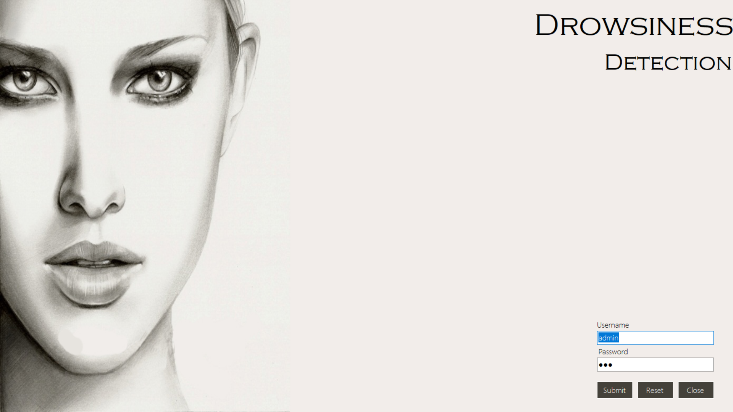
OUTPUT
LOGIN FORM

Slide 17

HOME FORM

Slide 18
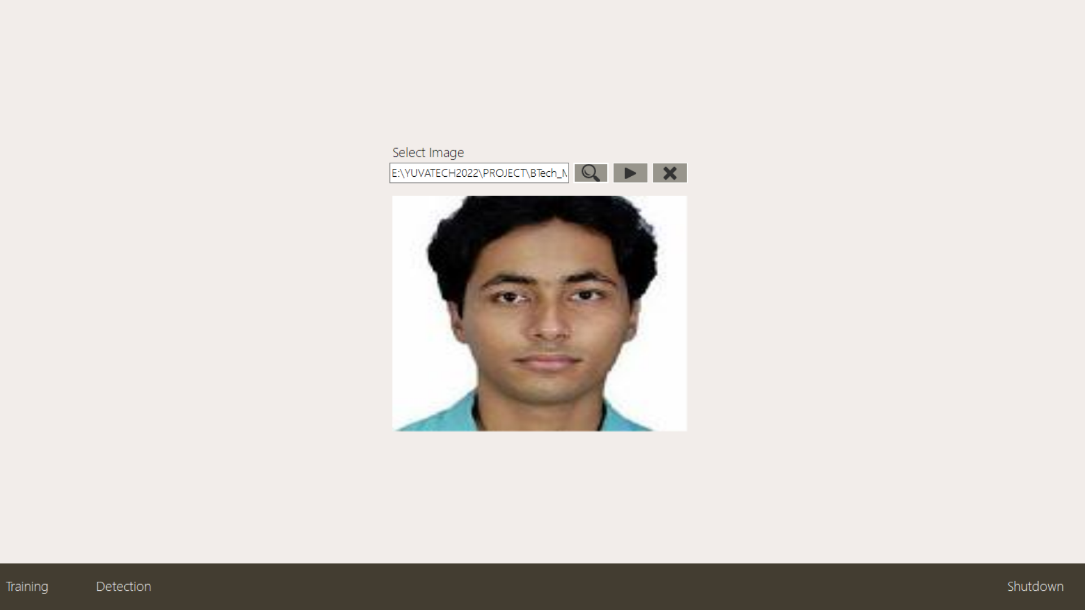
TRAINING

Slide 19
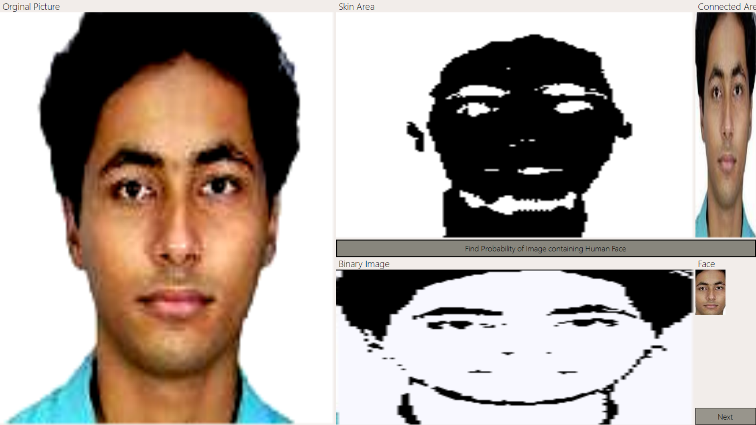
FACE DETECTION

Slide 20
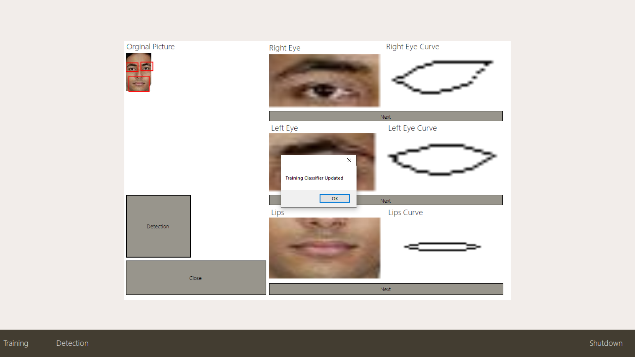
TRAIN DATASET

Slide 21
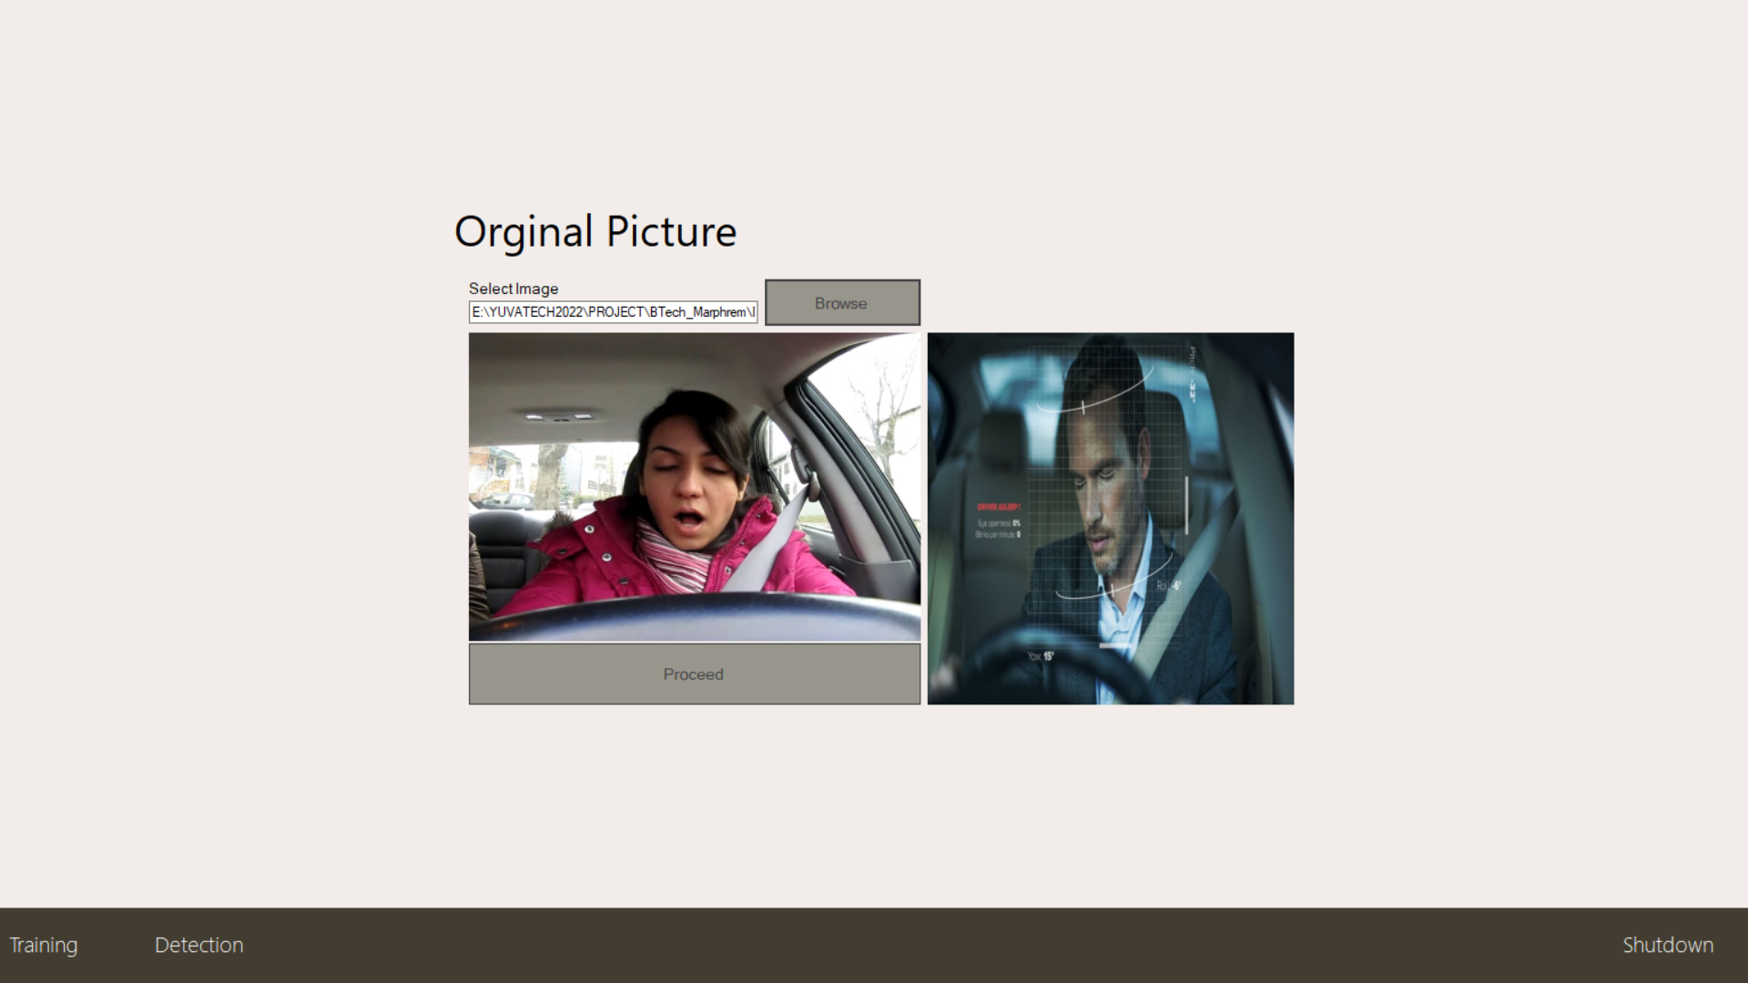
DETECTION

Slide 22
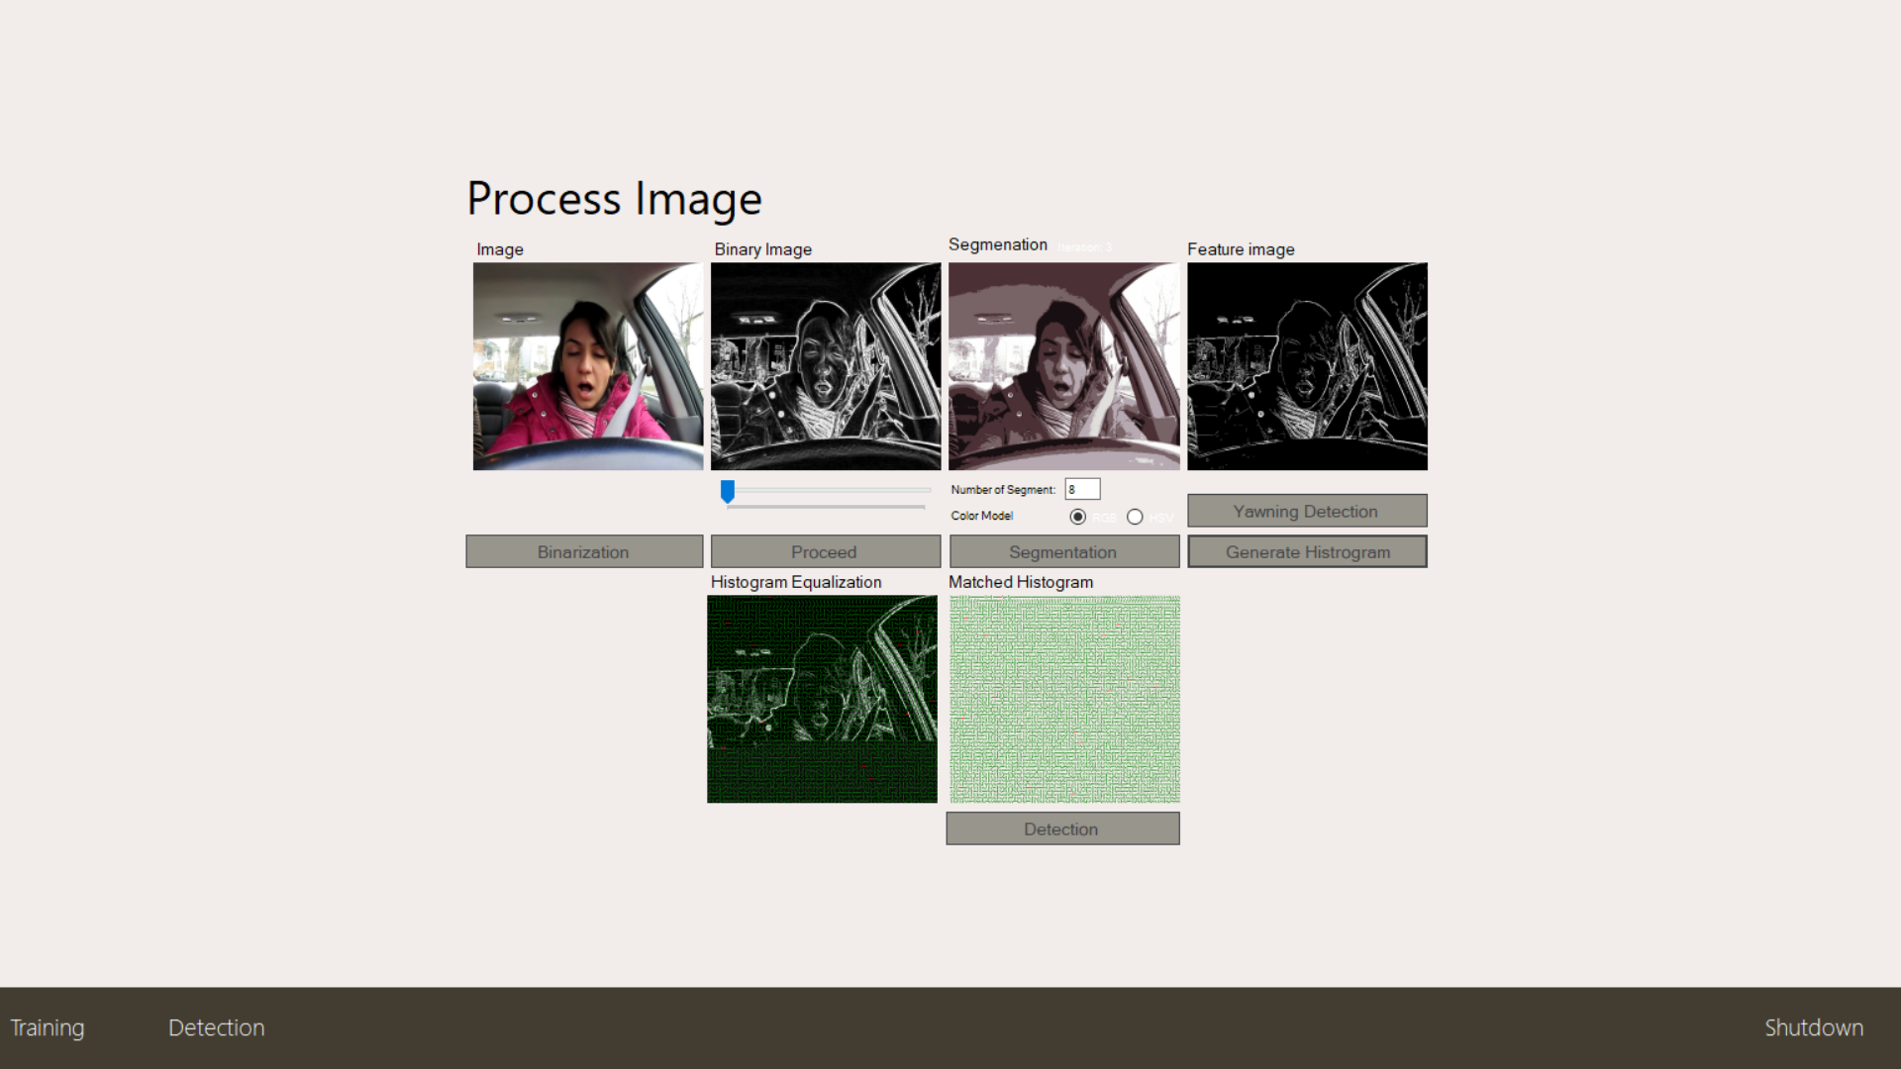
PROCESSING

Slide 23
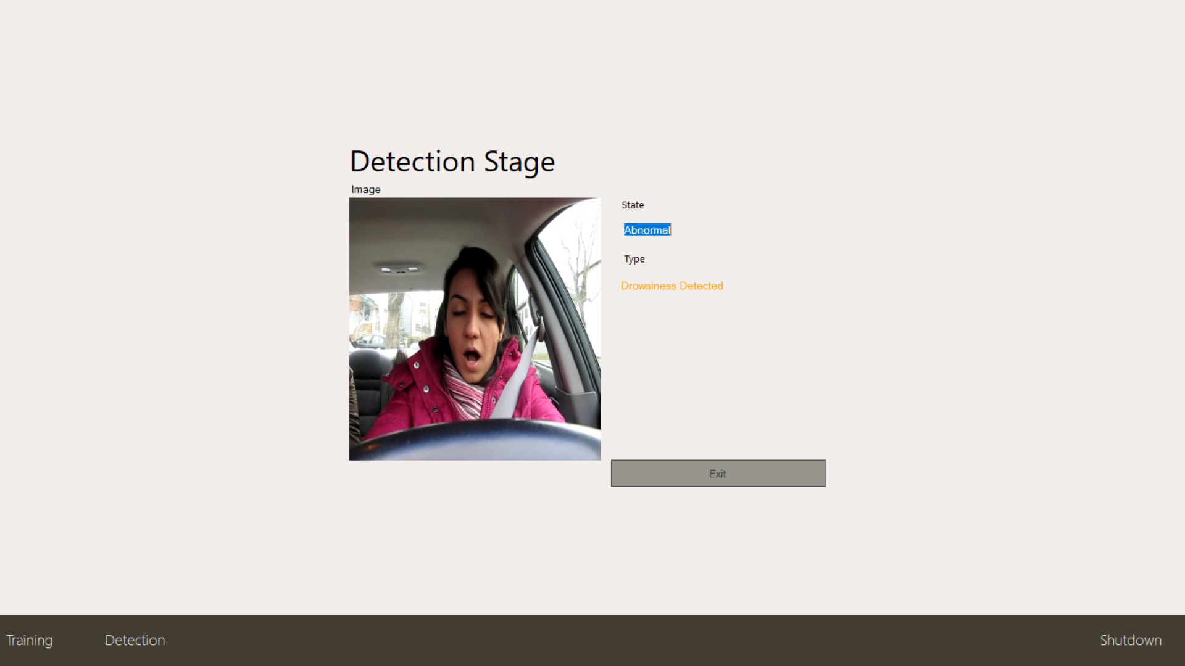
DETECTION

Slide 24
PERFORMANCE ANALYSIS

Slide 25
Conclusion & FUTURE WORK
In this project, we have implemented the application of support vector machine and image processing clustering methods for real-time classifications and video analysis, which takes input from corresponding hardware. The algorithm has been implemented and tested under various input parameters. It was observed that the proposed algorithm worked with better accuracy under illumination conditions with optimum distance from the camera.
It requires a special hardware support like all other biometrics system. This research work promises a new direction of research in the field of asymmetric biometric cryptosystems which is highly desirable in order to get rid of passwords and smart cards completely.

Slide 26
REFERENCES
[1] F. Guede-Fernández, M. Fernández-Chimeno, J. Ramos-Castro, and M. A. García-González, ‘‘Driver drowsiness detection based on respiratory signal analysis,’’ IEEE Access, vol. 7, pp. 81826–81838, 2019, doi: 10.1109/ACCESS.2019.2924481.
[2] Y. Saito, M. Itoh, and T. Inagaki, ‘‘Driver assistance system with a dual control scheme: Effectiveness of identifying driver drowsiness and preventing lane departure accidents,’’ IEEE Trans. Human-Mach. Syst., vol. 46, no. 5, pp. 660–671, Oct. 2016, doi: 10.1109/THMS.2016.2549032.
[3] J. Yu, S. Park, S. Lee, and M. Jeon, ‘‘Driver drowsiness detection using condition-adaptive representation learning framework,’’ IEEE Trans. Intell. Transp. Syst., vol. 20, no. 11, pp. 4206–4218, Nov. 2019, doi: 10.1109/TITS.2018.2883823.
[4] Y. Hu, M. Lu, C. Xie, and X. Lu, ‘‘Driver drowsiness recognition via 3D conditional GAN and two-level attention Bi-LSTM,’’ IEEE Trans. Circuits Syst. Video Technol., vol. 30, no. 12, pp. 4755–4768, Dec. 2020, doi: 10.1109/TCSVT.2019.2958188.
[5] G. Li and W.-Y. Chung, ‘‘Combined EEG-gyroscope-tDCS brain machine interface system for early management of driver drowsiness,’’ IEEE Trans. Human-Mach. Syst., vol. 48, no. 1, pp. 50–62, Feb. 2018, doi: 10.1109/THMS.2017.2759808.

Slide 27
[6] G. Li, B.-L. Lee, and W.-Y. Chung, ‘‘Smartwatch-based wearable EEG system for driver drowsiness detection,’’ IEEE Sensors J., vol. 15, no. 12, pp. 7169–7180, Dec. 2015, doi: 10.1109/JSEN.2015.2473679.
[7] M. Sunagawa, S.-I. Shikii, W. Nakai, M. Mochizuki, K. Kusukame, and H. Kitajima, ‘‘Comprehensive drowsiness level detection model combining multimodal information,’’ IEEE Sensors J., vol. 20, no. 7, pp. 3709–3717, 2020, doi: 10.1109/JSEN.2019.2960158
[8] A. Dasgupta, D. Rahman, and A. Routray, ‘‘A smartphone-based drowsiness detection and warning system for automotive drivers,’’ IEEE Trans. Intell. Transp. Syst., vol. 20, no. 11, pp. 4045–4054, Nov. 2019, doi: 10.1109/TITS.2018.2879609.

